Slide 1
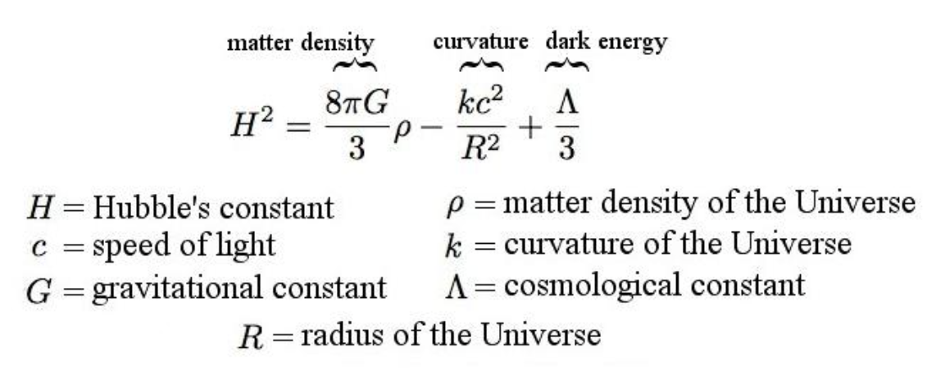
Modern Cosmology

Slide 2
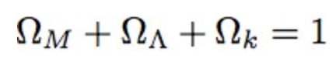
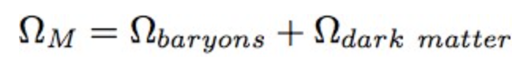
A simplified version
Mass density
Dark energy
Curvature

Slide 3
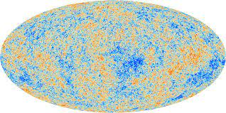
Curvature of the Universe is measured by the Cosmic Microwave Background (CMB)

Slide 4
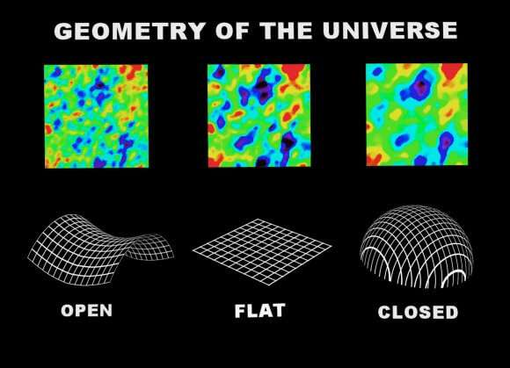

Slide 5
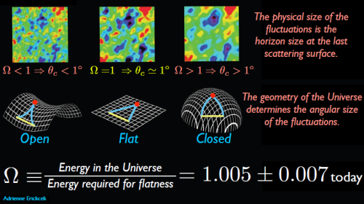

Slide 6
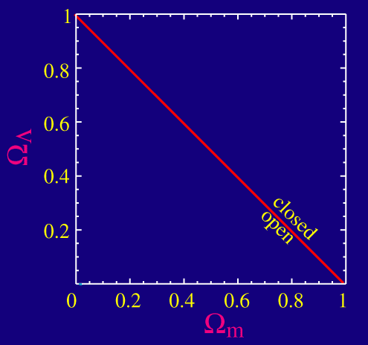

Slide 7
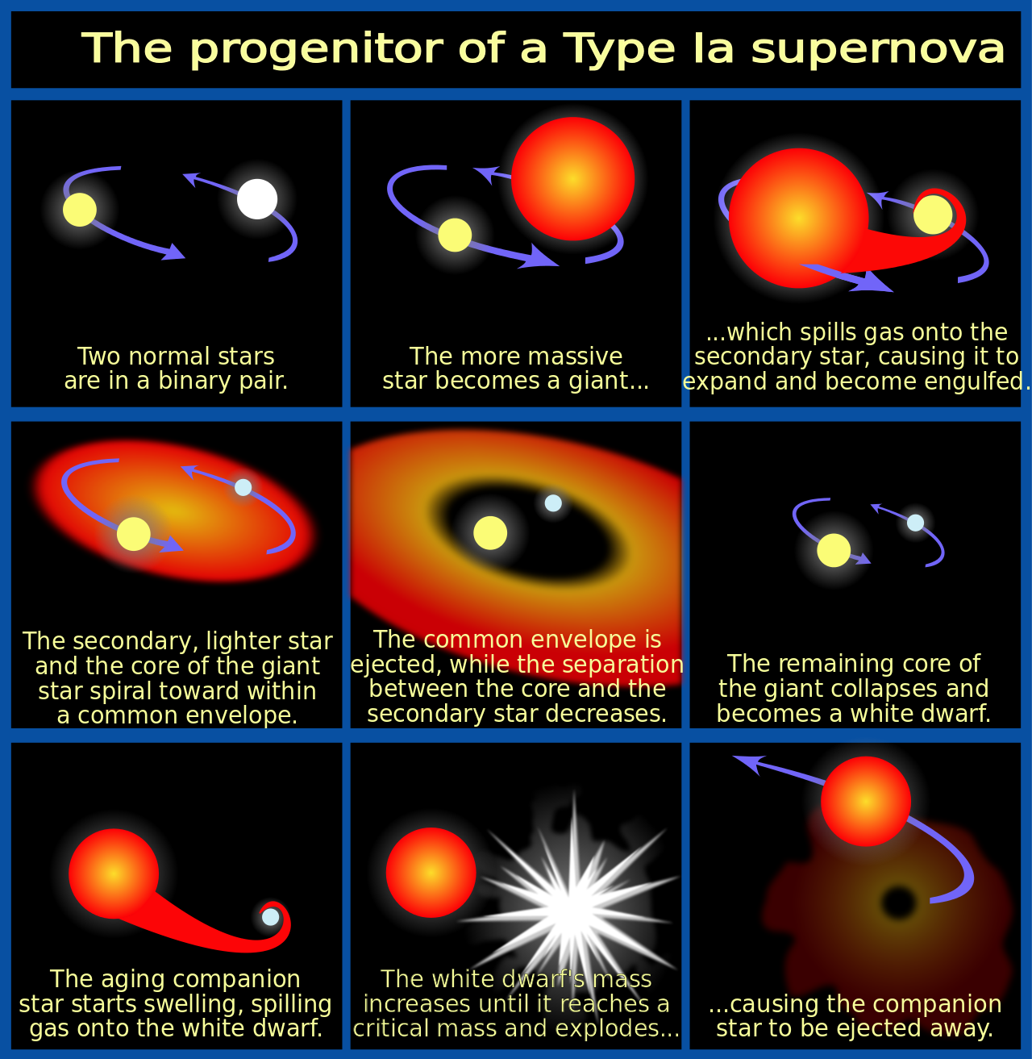

Slide 8
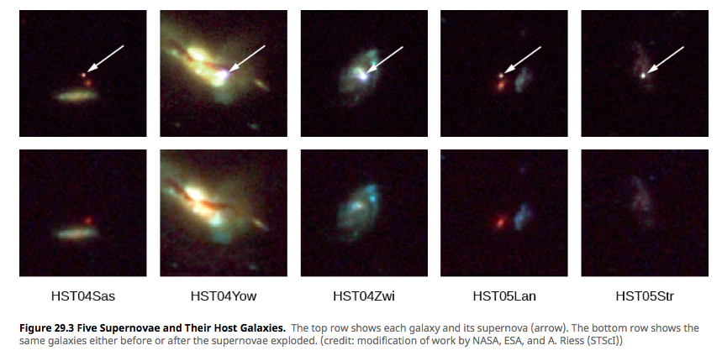
The Universe is accelerating!
Supernovae at high redshift appear to be fainter than expected from Hubble law

Slide 9
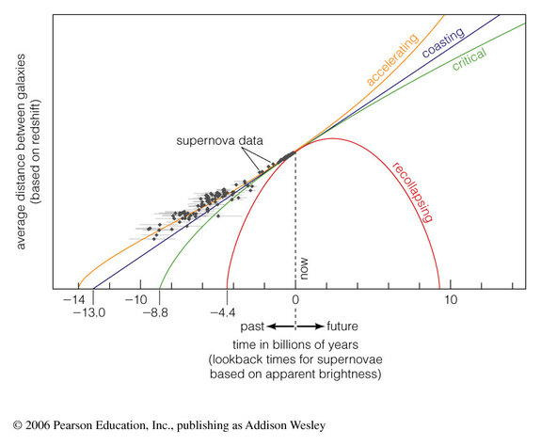

Slide 10
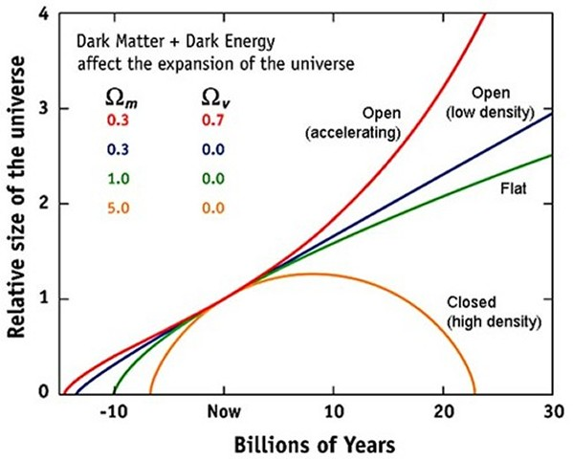
Accelerating
Accelerating
Constant
Decelerating

Slide 12
Group discussion
What will happen if the universe continues expanding and stretching?
distance between stars and galaxies?
What happens to stars as they all evolve?
What are the last stars remaining shining
Then what happens?
Notes:
What will happen if the universe continues expanding and stretching (distance between stars and galaxies, stars->WD, NS->black out, BD the last become, then all black out! (Class activity)

Slide 13
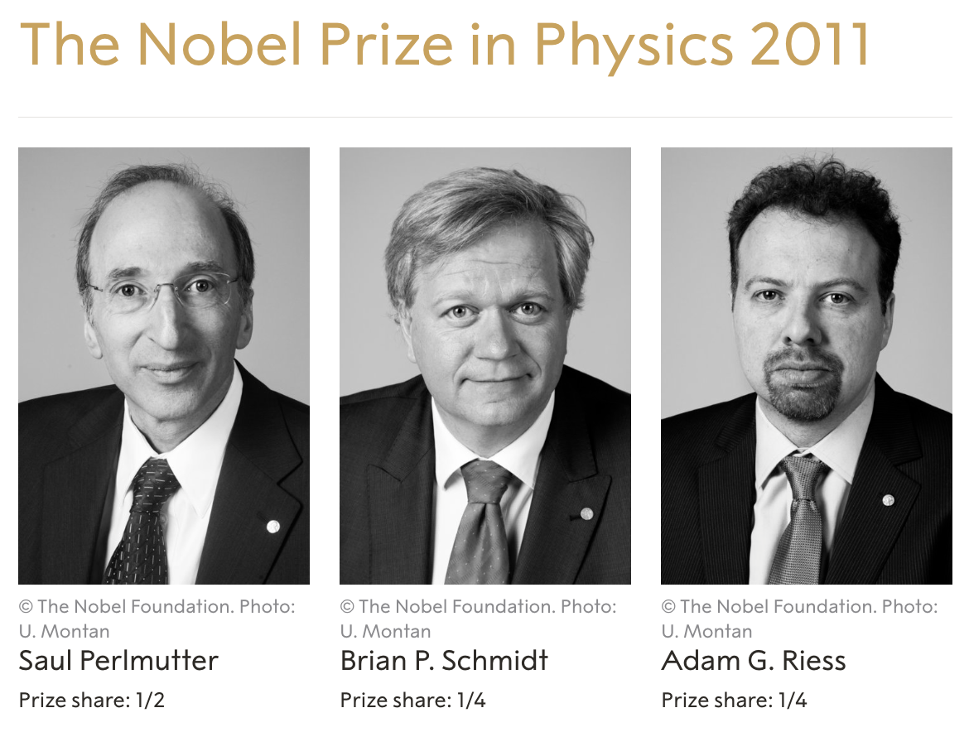

Slide 14
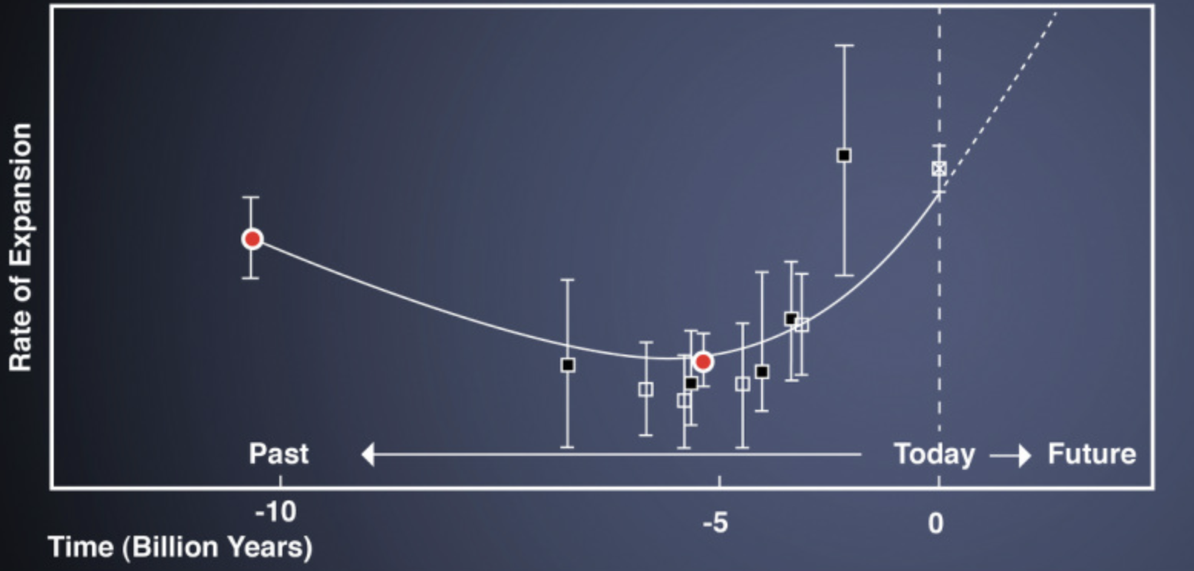
The expansion history of the universe
Radiation dominated
Dark energy dominated
Matter dominated
Notes:
http://abyss.uoregon.edu/~js/ast123/lectures/lec16.html

Slide 15
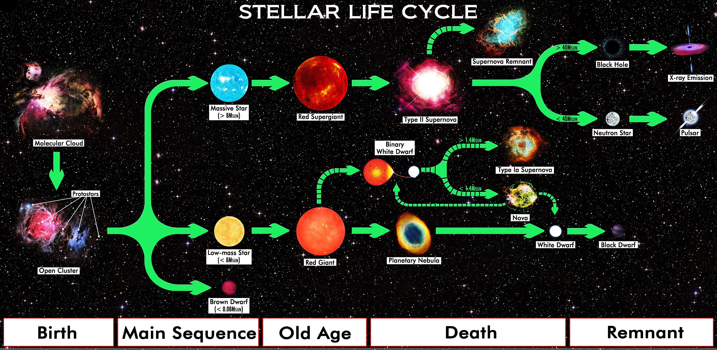

Slide 16
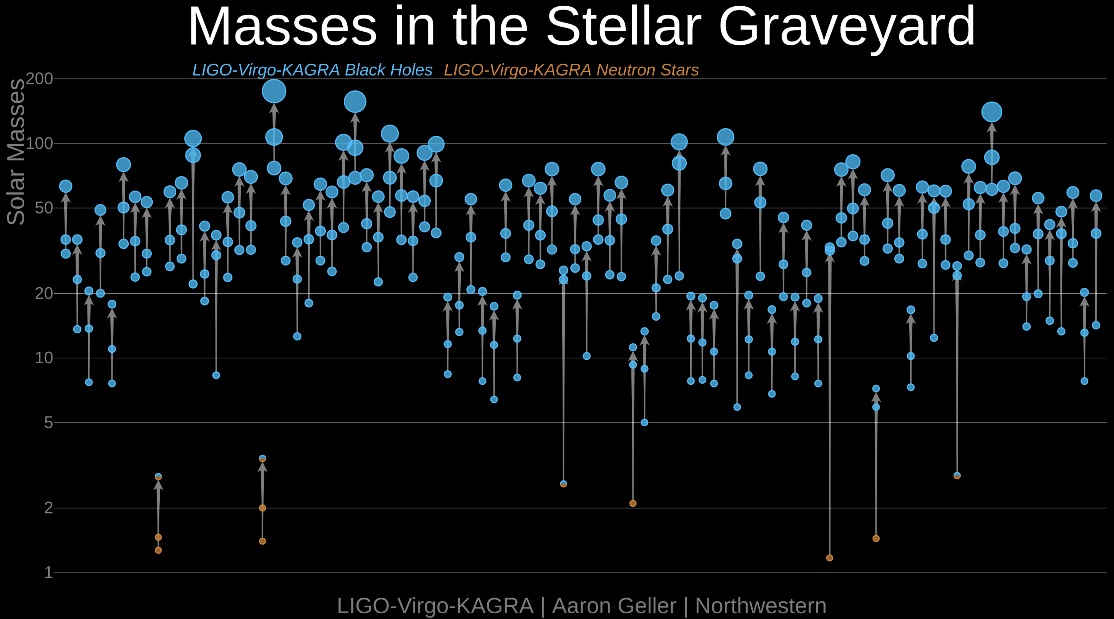

Slide 17
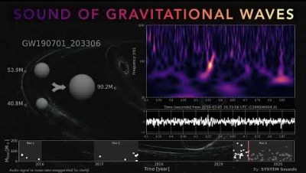

Slide 18
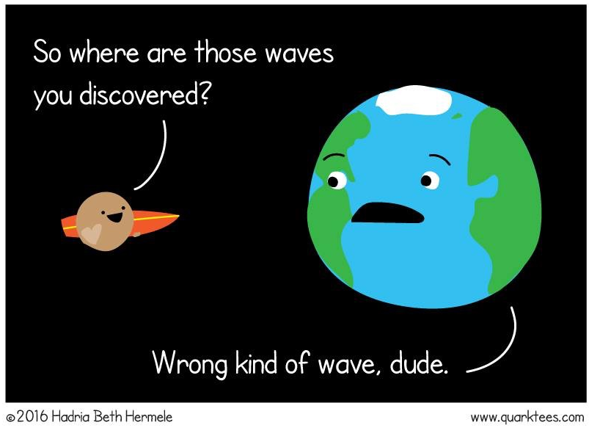
What are gravitational waves?
NOT an excuse to go surfing.

Slide 19
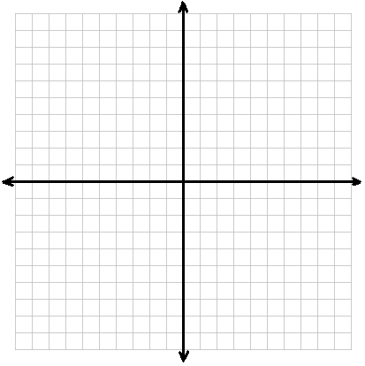

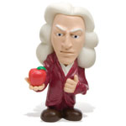
Isaac Newton’s view: Space is flat (it follows Euclid’s laws). Space is static.

Slide 20
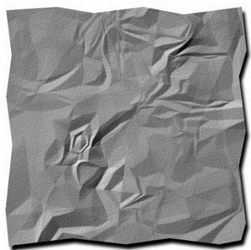
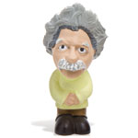
Albert Einstein’s view: Space is curved. Space is changeable.

Slide 21
Einstein’s view: Space can shrink or expand.

Slide 22


Einstein’s view: Space can have moving ‘ripples’.
These are called gravitational waves.

Slide 23
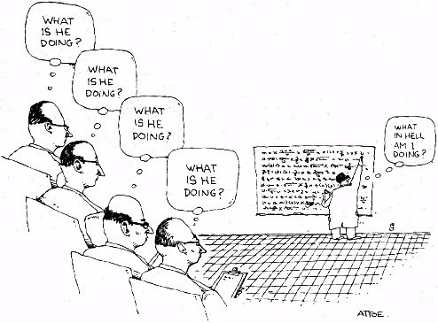
What is he doing?
What is he doing?
What is he doing?
What in hell am I doing?
What is he doing?

Slide 24
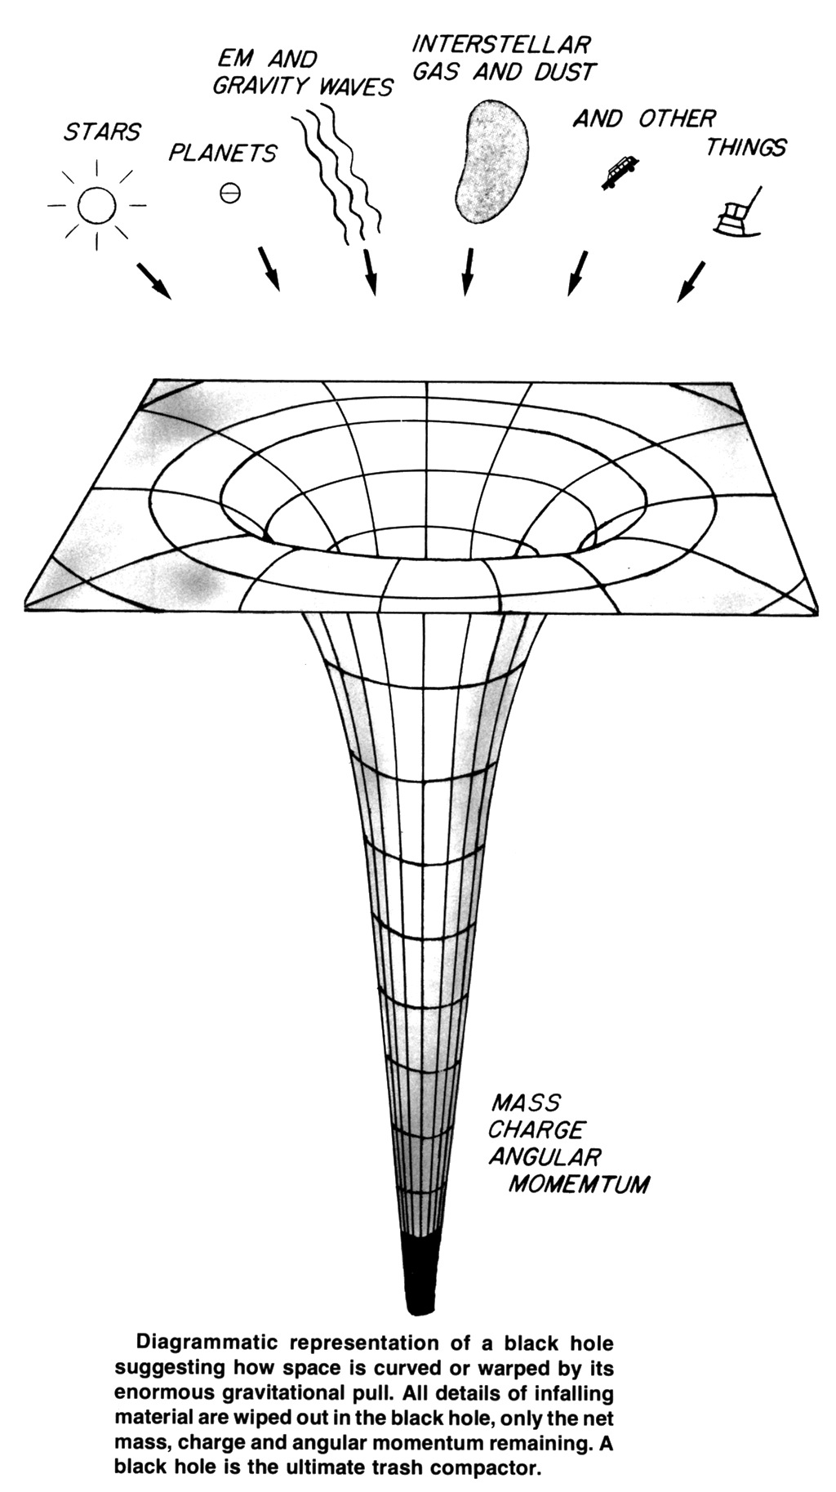
Suppose you make a black hole…
…and then you make another black hole.
The two black holes will then orbit each other.

Slide 25
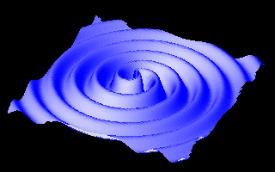
As the black holes orbit, they make expanding waves in space.

Slide 26
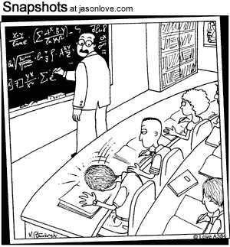
Professor Herman stopped when he heard that unmistakable thud – another brain had imploded.

Slide 27
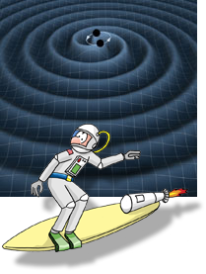
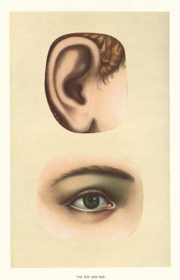
How do we test whether gravitational waves exist?
The universe contains different types of waves: sound waves, light waves, gravitational waves…
Each type of wave is detected with a different technique.

Slide 28
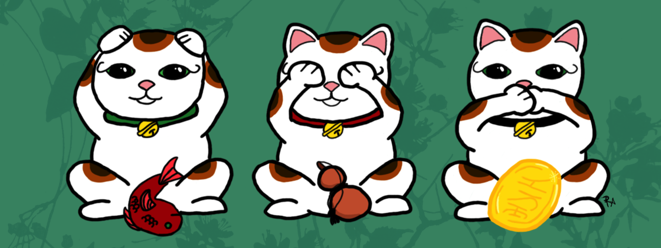
Gravitational waves can’t be heard, can’t be seen, can’t be tasted.

Slide 29
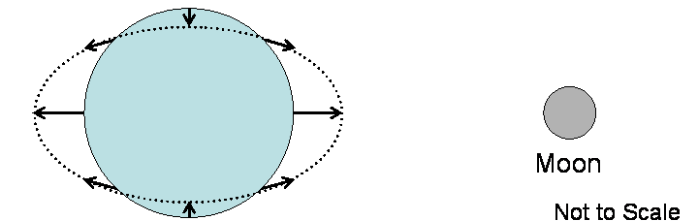
Ordinary tides stretch the Earth in the direction of the Moon, squeeze it in the perpendicular directions.

Slide 30
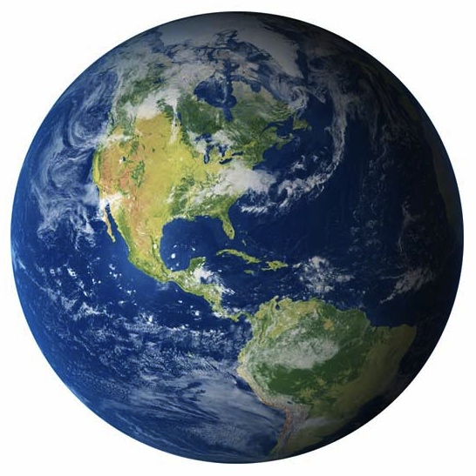
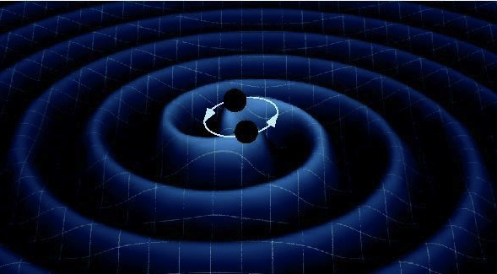
The changing tides from gravitational waves first stretch the Earth in the direction of the two black holes…
…and then squeeze it in the same direction.

Slide 31
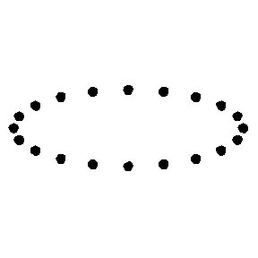
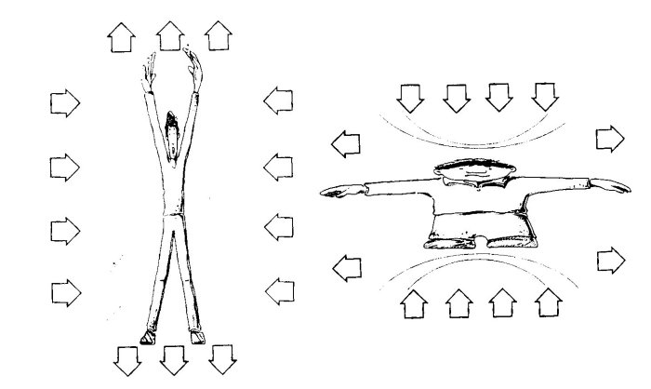
Gravitational waves knead you.

Slide 32
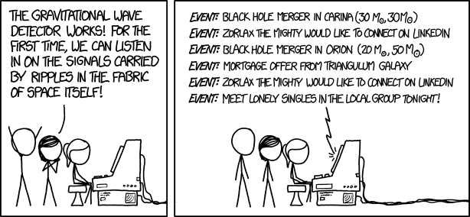

Slide 33
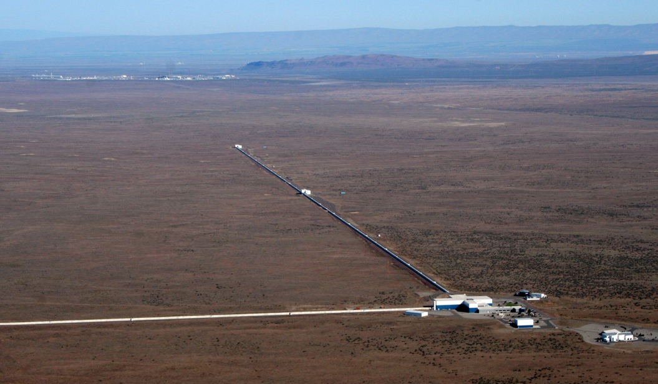
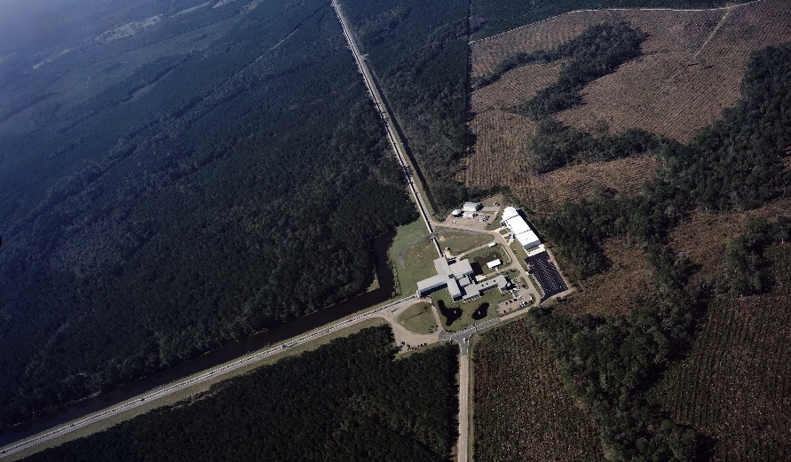
Measuring tiny ripples requires sensitive equipment, like the Laser Interferometer Gravitational-wave Observatory (LIGO).
A gravitational wave changes that distance by one part in 10²¹ (one billion trillion).

Slide 34
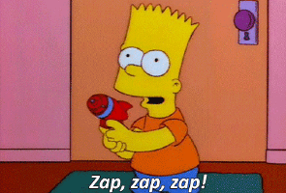
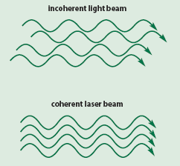
How can you measure such an infinitesimal change in length?
This is where lasers come in.
Laser light is coherent: all waves have the same wavelength and the same phase (crests and troughs line up).

Slide 35
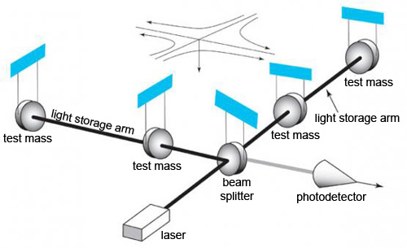
Laser light is sent down both arms of LIGO, reflected from mirrors at the ends, and brought together by a “beam splitter”.

Slide 36
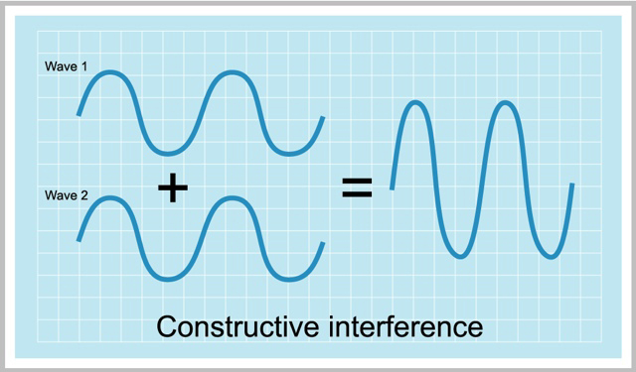
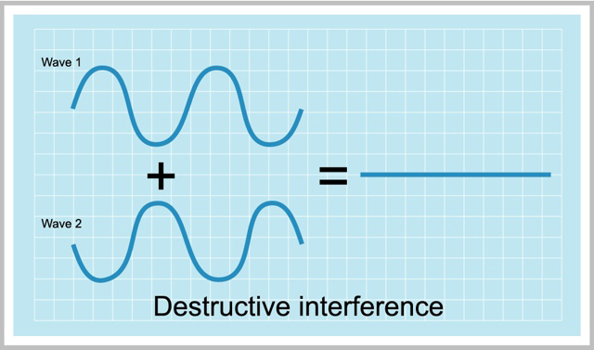
Light waves can either add together or cancel each other out.
LIGO is “tuned” so that laser light from the two arms cancels out in the absence of gravitational waves.

Slide 37
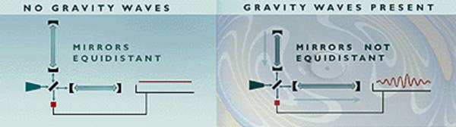
In the presence of gravitational waves, the two arms are slightly different in length, and the light doesn’t exactly cancel out.

Slide 38


Slide 39
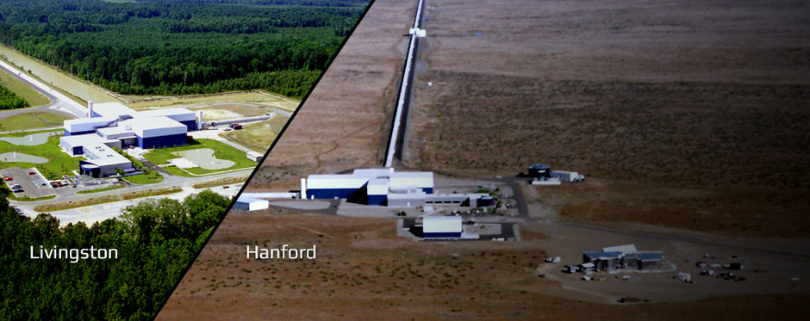
The problem with LIGO: it’s the world’s most sensitive seismometer.
It records minor tremors, trucks driving by, gusts of wind, etc…
How can you pick out the signal from this “noise”?

Slide 40
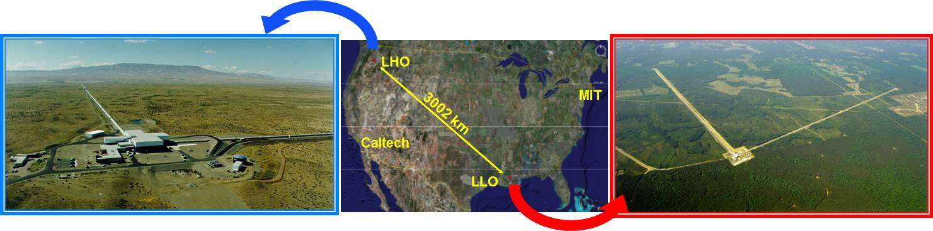
Step 1: look for signals seen at both locations.
It’s unlikely that a tremor hits Hanford at the same time a truck rumbles past Livingston.

Slide 41
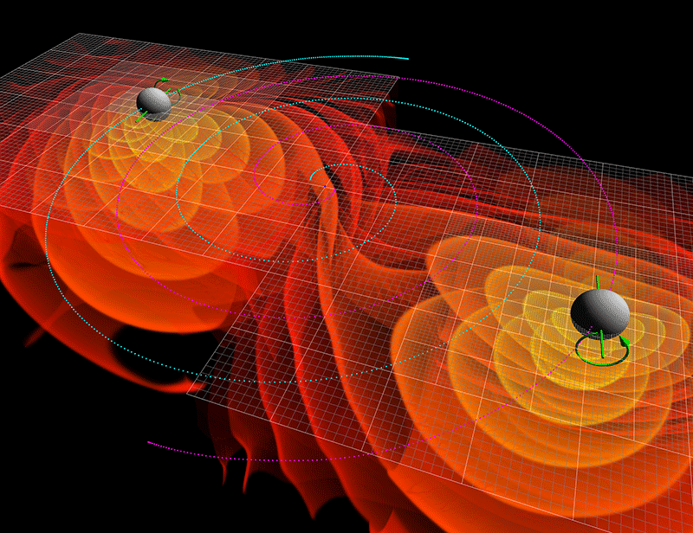
Step 2: look for the characteristic shape of the signal from two black holes.
As gravitational waves escape, they carry away energy.
As a result, the black holes spiral in toward each other, orbiting faster & faster.

Slide 42
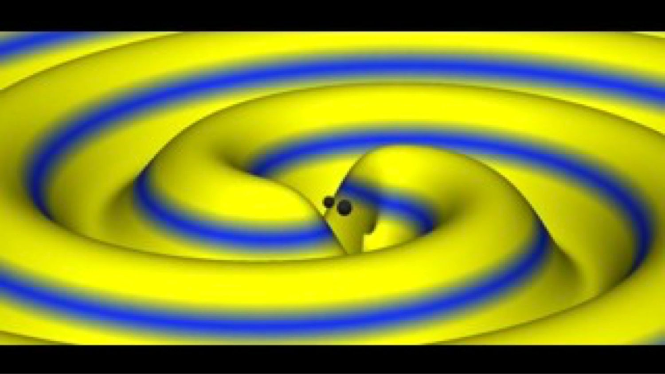

Slide 43
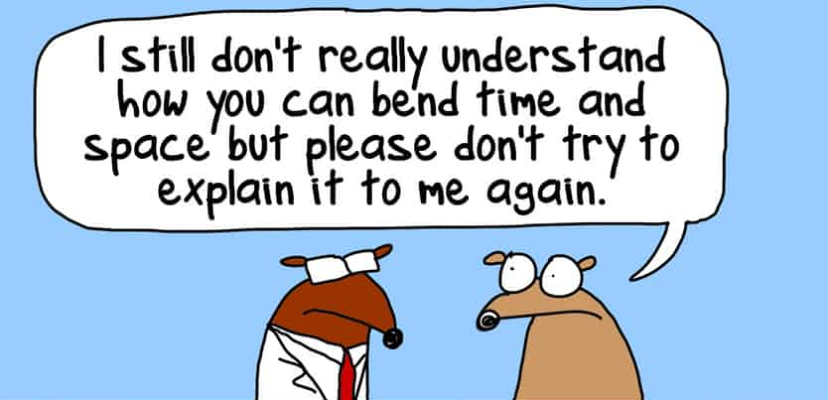

Slide 44
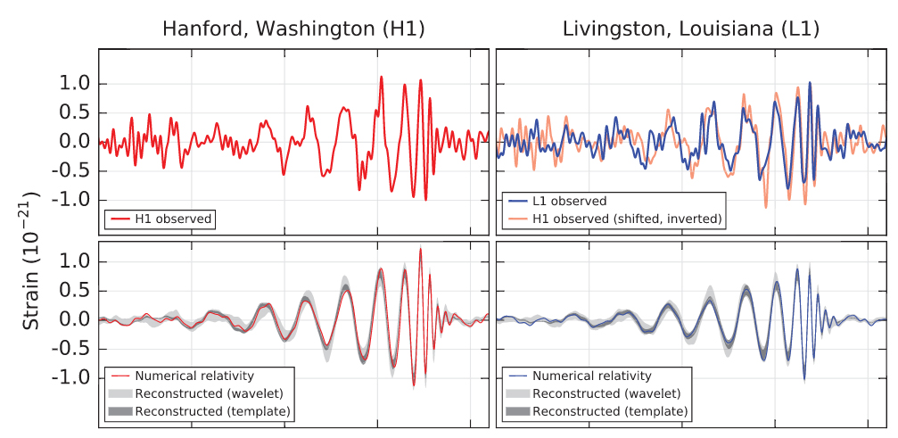
Eureka! Sept 14, 2015

Slide 45
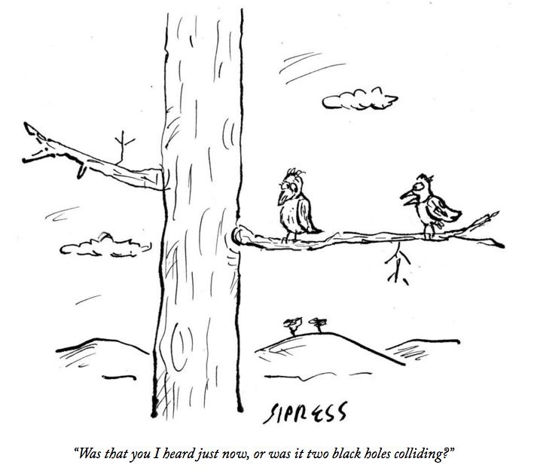
“Was that you I heard just now, or was it two black holes colliding?”

Slide 46
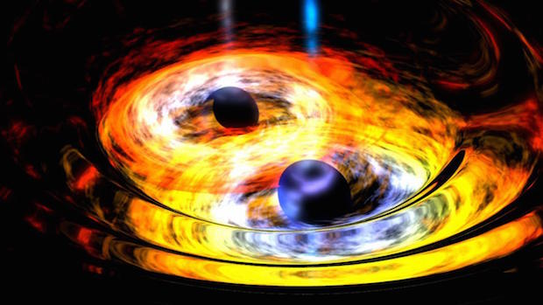
What caused this ripple in space-time?
The inward spiral & merger of 2 black holes.
One was 29 times the Sun’s mass, the other was 36 times the Sun’s mass.
The merged black hole is 62 times the Sun’s mass.
The missing mass was changed to energy, & carried off by gravitational waves.

Slide 47
The Sun converts < 1% of its mass to energy over 10 billion years.
The black holes converted 3 times the Sun’s mass to energy in 200 milliseconds.
An incredibly powerful event!
And yet, it caused only a minuscule twitch in the LIGO apparatus.
The black hole merger was very far away…
about 1.6 billion light-years!

Slide 48

Thousands of people have worked on LIGO. Why were Weiss, Thorne, & Barish picked for the Nobel Prize?
1972: Weiss has 1st idea for interferometer.
1975: Weiss & Thorne sit up all night planning LIGO.
1981: They make a prototype at Caltech.
1994: Ground is broken for LIGO; Barish becomes Principal Investigator, brings order out of chaos.

